Slide 1
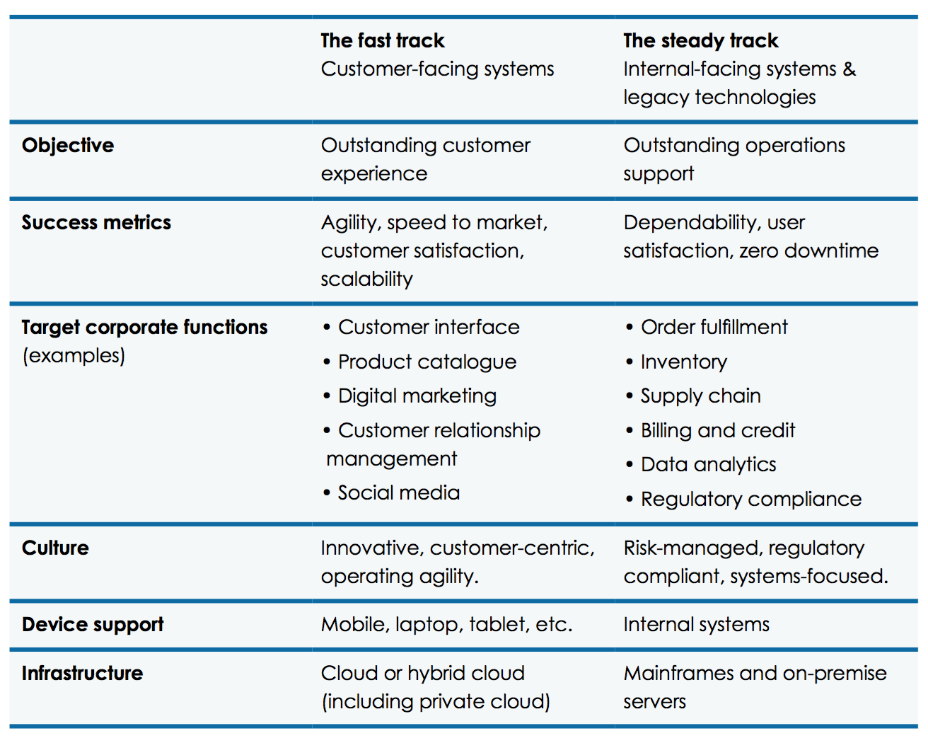
Source: Economist Intelligence Unit Solving the CIO’s disruption dilemma— the blended IT strategy

Slide 2


Slide 3
ERP Example: SAP
SD
Sales and
Distribution
FI
Financial
Accounting
MM
Materials
Mgmt.
CO
Controlling
PP
Production
Planning
AM
Fixed Assets
Mgmt.
SAP ERP
ECC
SM
Service
Mgmt.
EC
Enterprise
Controlling
QM
Quality
Mgmt.
PS
Project
System
PM
Plant Maintenance
WF
Workflow
HR
Human
Resources
IS
Industry
Solutions

Slide 4
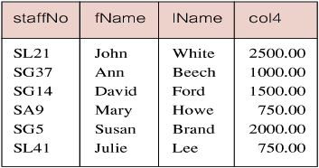
Calculated Fields Example 6.4 Produce a list of monthly salaries for all staff, showing staff number, first/last name, and salary.
Produce list of monthly salaries for all staff, showing staff number, first/last name, and salary.
SELECT staffNo, fName, lName, salary/12
FROM Staff;

Slide 5
WHERE Statement
SELECT Specifies which columns are to appear in output (columns in new table -- vertical)
FROM Specifies table(s) to be used (raw materials)
WHERE Filters rows (rows in new table -- horizontal)
GROUP BY Forms groups of rows with same column value
HAVING Filters groups subject to some condition
ORDER BY Specifies the order of the output

Slide 6
WHERE
Several approaches to filter rows
Comparison
Range
Set Membership
Pattern Match
NULL
Can be combined with “AND” or “OR”

Slide 7
BETWEEN-AND (Range Search Condition - Example 6.7)
The BETWEEN operator selects values within a given range. The values can be numbers, text, or dates.
The BETWEEN operator is inclusive: begin and end values are included.
6.7
6.7

Slide 8
IN/NOT IN (Set Membership Search Condition – Example 6.8)
Tests whether a data value matches one of a list of values

Slide 9
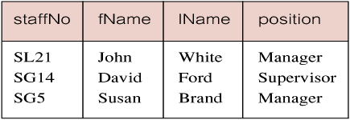
Example 6.8: Set Membership
List all managers and supervisors.
SELECT staffNo, fName, lName, position
FROM Staff
WHERE position IN (‘Manager’, ‘Supervisor’);

Slide 10
Example 6.9: Pattern Matching
SQL has two special pattern matching symbols (wildcards):
%: sequence of zero or more characters
_: any single character
LIKE ‘%Glasgow%’ means a sequence of characters of any length containing ‘Glasgow’.
LIKE ‘G%’ means a sequence of characters of any length starting with ‘G’.
LIKE ‘%G’ means a sequence of characters of any length ending with ‘G’.
VERY USEFUL and PRACTICAL.
E.g. forget one’s last name but remember it starts with Y
LIKE ‘?’

Slide 11
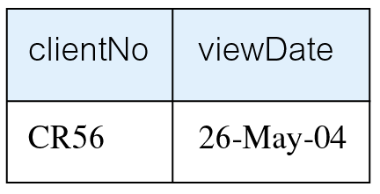
Example 6.10: NULL Search Condition
List details of all viewings on property PG4 where a comment has not been supplied.
There are 2 viewings for property PG4, one with and one without a comment.
Have to test for NULL explicitly using special keyword IS NULL:
SELECT clientNo, viewDate
FROM Viewing
WHERE propertyNo = ‘PG4’ AND comment IS NULL;
Negated version (IS NOT NULL) can test for non-NULL values.

